Slide 1
Musculoskeletal deficiencies student’s Name institutional affiliation
Supracondylar Fracture

Slide 2
Supracondylar Fracture
A supracondylar fracture is an injury to the humerus just above the elbow joint.
It is the most common type of elbow fracture in children under 7 years old.
Supracondylar fractures are very rare in adults.
They account for up to 60 percent of pediatric elbow fractures.
Supracondylar fractures are frequently caused by a fall on an outstretched elbow.
Complications of supracondylar fracture include injury to nerves and blood vessels.
Notes:
A supracondylar fracture is an injury to humerus just above the elbow. It is common in children 5-7 years of age. Such fractures are mainly caused by a fall on an outstretched elbow.

Slide 3
Symptoms of supracondylar fracture
Swelling around the elbow.
Numbness in the hand
Inability to straighten or move the arm
Sudden intense pain in the forearm and elbow
Notes:
Common symptoms of supracondylar fracture are numbness in the hand, swelling around the elbow, inability to move the am and sudden intense pain in the elbow.

Slide 4
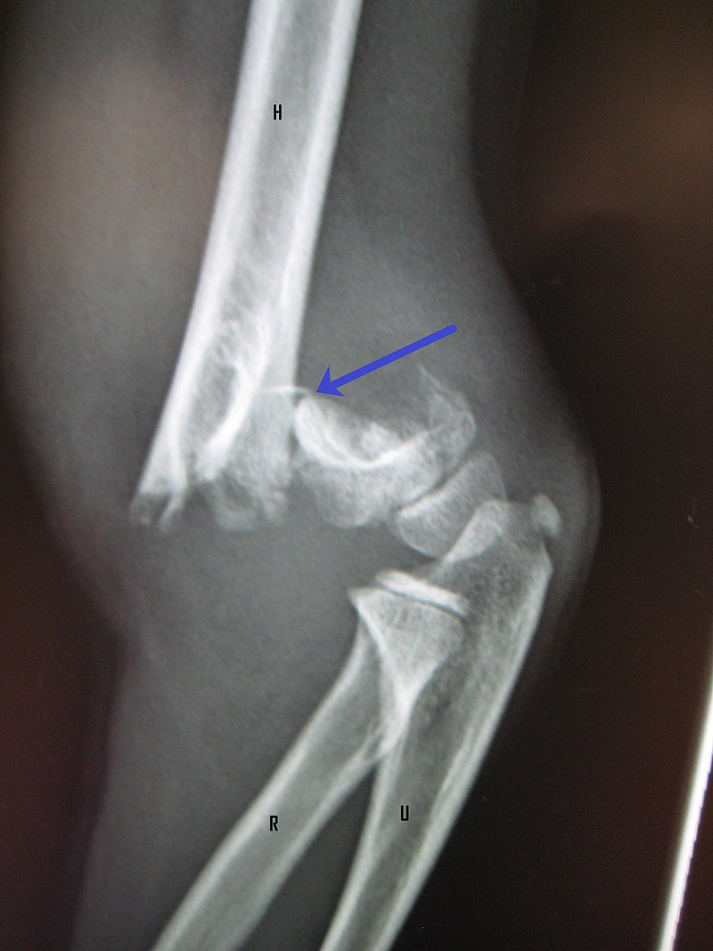
Photograph showing a supracondylar fracture in a young child

Slide 5
How to provide first aid care for supracondylar fracture
Applying cold ice cube that is wrapped inside a cloth specifically to the area that is fractured for some time more than ten minutes.
Immobilizing the specific area that is injured. For instance, in the case of supracondylar fracture it is advisable to make them remain still using a sling. The cuff sling is then placed in a fixed position to the collar through a sling to suspend the hand and prevent edema.
Applying shock absorbers to help them get into their original position to ensure that they have in their resting position by covering the place with a warm cloth.
In case the fracture has bleeding, it is recommended to cease any bleeding by elevating and applying pressure to the fractured area using a bandage with a piece of cloth that I clean.

Slide 6
steps to providing first-aid for a supracondylar fracture
Stop any bleeding
Immobilize the injured area using a sling or splint
Apply cold to the area like an ice pack
Treat them for a shock: make them comfortable position, make them rest.
Get professional help

Slide 7
How to create an emergency splint after supracondylar fractures
Do not move the injured child (patient)
Assess the injury
Straightening
Immobilize both the bone above and below the joint
Place the splint
Check any sensation and pulse below the splint

Slide 8
How to splint a supracondylar fractures
Splints can be made from basic materials or can be ready-made.
Splinting should be done for all types of fractures before the person is moved to minimize further injury.
In case of a severe fracture the elbow should be straightened by the doctor if pulses are impaired prior to splinting.
A basic rule of splinting should apply. The rule states that the joint above and below the broken bone should be immobilized to protect the fractured area.
Sensation and pulses should be checked below the splint once every hour.

Slide 9
Risk factors for supracondylar fractures
Supracondylar fractures are most common to children
They are more common to boys than girls
The injury is more likely to occur during summer
They require surgery

Slide 10
Diagnosing supracondylar fractures
Supracondylar fractures can be diagnosed using X-ray imaging.
A computed tomography (CT scan) is also used to give a 3D image of the affected area.
Magnetic resonance imaging (MRI) is used to show more details if the fracture is small.
The doctor uses X-rays to determine where the fracture has occurred and to distinguish supracondylar fractures from any other type of fractures.
The doctor then classifies the type of fracture using the Gartland system.
In case of an extension fracture, the humerus has been pushed backward from the elbow joint.
In case of a flexion injury, it means that the injury has been caused by a rotation of the elbow.
Notes:
Supracondylar fractures can be diagnosed through X-ray imaging, CT scan, and Magnetic resonance imaging. The Gartland system is used to classify fractures.

Slide 11
Classification of supracondylar fractures
Type 1: represents non-displaced fractures
Type II: angulated with intact posterior context
Type III: complete displacement but have lateral contact. Humerus severely displaced.
Type IV: periostial disruption with in both extension and flexion. Humerus severely displaced.
Notes:
Supracondylar fractures are classified into Type I, Type II, Type III and Type IV depending on their severity.

Slide 12
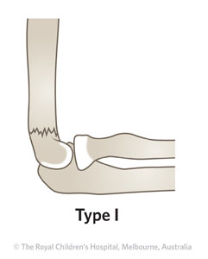
Type I fracture
Notes:
This photo represents type I fracture. It shows undisplaced fracture.

Slide 13
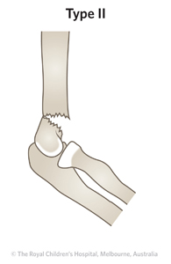
Type II fracture
Notes:
This is Type II fracture showing angulated fracture with intact posterior cortex.

Slide 14
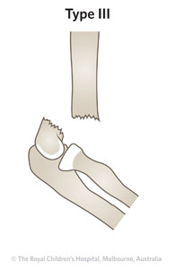
Type III fracture
Notes:
This is a type III fracture showing complete displacement with no cortical contact.

Slide 15
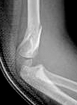
Gartland type II with coronal plane deformity

Slide 16
Treatment
Treatment depends on the type and severity of the injury. Treatment methods include:
Closed reduction and percutaneous pinning (CRPP) is used to treat type II and III supracondylar fractures, and flexion type.
Type IV is treated mostly with CRPP or open reduction if needed.
CRPP involves not only resetting the bones but also inserting pins through the skin to rejoin the fractured parts of the bone.
Open reduction with internal fixation is applied when the displacement is very severe or there is damage to blood vessels or nerves.
Notes:
Treatment is determined by the severity of the injury. Treatment methods include CRPP, and open reduction with internal fixation.

Slide 17
Potential complications associated with supracondylar fractures
Gartland type II injuries are rarely associated with neurovascular problems. It may however, result in malunion or gunstock deformity.
Gartland type III injuries have the highest risk of neurovascular injury.
Cubitus valgus which is caused by fracture malunion
Recurvatum complications associated with non-operative treatment of Type II and Type III fractures.
Pin migration which is the most common complication.
Notes:
Complications associated with this type of fracture include malunion, gunstock deformity, cubitus valgus, recurvatum, and pin migration.

Slide 18
Conti…
Volkmann ischemic contracture. This is a rare but dreaded complication which may result from elbow hyper flexion casting.
Postoperative stiffness complication
Vascular injury
Notes:
Other complications are Volkmann ischemic contracture, postoperative stiffness and vascular injury.

Slide 19

The photograph shows someone suffering from supracondylar fracture

Slide 20
Precautions to be taken for proper recovery
The child will need to wear a splint for three to six weeks
The splint helps to elevate the injured elbow
Visit the doctor regularly to make sure the fractured bone is rejoining properly.
The doctor may recommend for exercises to improve the elbow range of motion as healing continues.
Wear loose-fitting shirts and let the sleeve on the cast side hang free.
Notes:
In order for your child to recover well, it will need to wear a splint for 3-6 weeks, visit the doctor regularly, wear loose-fitting shirts and do more exercises.

Slide 21
Assessing the patient
Some pain is likely to be felt after the pins and cast are in place. Pain relievers such as ibuprofen, Tylenol and aspirin may be helpful for relieving the pain.
Pins should be removed by the doctor 3-4 weeks after surgery. There is no need for anesthesia.
Total recovery time varies but typically if pins were used, recovery time ranges from six to seven weeks.
The child may return to school within 3-4 days after surgery but they should abstain from playing and other sports.
Notes:
After surgery be sure to take pain relievers like aspirin and Tylenol, remove pins after 3-4 weeks, and abstain from sport activities.

Slide 22
References
Labelle, H., Bunnell, W. P., Duhaime, M., & Poitras, B. (1982). Cubitus varus deformity following supracondylar fractures of the humerus in children. Journal of pediatric orthopedics, 2(5), 539-546.
Otsuka, N. Y., & Kasser, J. R. (1997). Supracondylar fractures of the humerus in children. JAAOS-Journal of the American Academy of Orthopedic Surgeons, 5(1), 19-26.
Pirone, A. M., Graham, H. K., & Krajbich, J. I. (1988). Management of displaced extension-type supracondylar fractures of the humerus in children. The Journal of bone and joint surgery. American volume, 70(5), 641-650.

